Slide 1
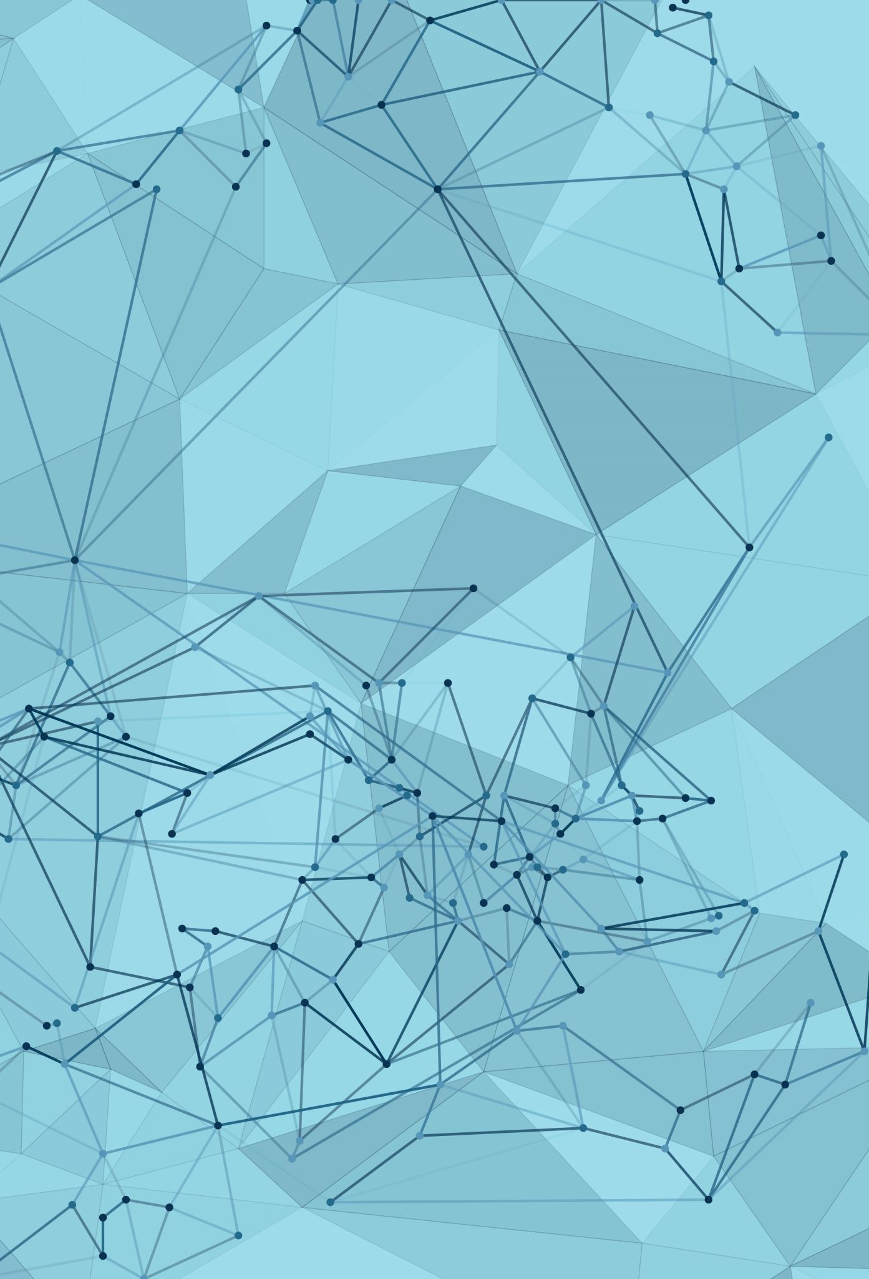
Agile Software Development
How Agile Improves Team Collaboration and Project Success
Josh Kelly
CS 250 - Software Development Lifecycle
Professor Haruka Konishi
8/17/25
This presentation compares Agile and Waterfall. The goal is to explain their differences, show where each works best, and tie the lessons back to what we learned in class. Professor Haruka Konishi has emphasized how important it is to know both methods, so we can make the right choice depending on the project.

Slide 2
Agile Roles
Scrum Master – keeps the team on track, removes roadblocks
Product Owner – speaks for the customer, manages backlog
Developers/Testers – create and test features, work together every day
Why it matters – roles balance leadership, customers, and teamwork (Lindsjørn et al., 2016)
The Scrum Master behaves more like a coach than a boss. They ensure the team is Agile and eliminate impediments that hinder progress. The Product Owner is the voice of the customer, making choices about what features are most important and keeping the backlog ranked. Developers and testers actually create and test the product, but they differ from Waterfall in that they cooperate with one another and the Product Owner. These roles balance leadership, customer advocacy, and teamwork, which studies have demonstrated produces stronger outcomes.

Slide 3
Agile SDLC Phases
Planning – develop backlog, sprint planning
Development – small iterations, pair programming
Testing – continuous integration, rapid fixes for bugs
Deployment – release small increments often
Review/Retrospective – reflect, improve, adjust (Miller et al., 2021)
Agile doesn’t attempt planning all the details far in advance. Teams, instead, plan brief spurts based on the backlog. Development occurs in tiny bits, at times pair programming so knowledge is shared. Testing occurs regularly, so bugs are found soon. Incremental deployment occurs regularly, which provides customer feedback earlier. After every sprint, the team assesses progress and discusses what they can do better. This cycle of planning, building, testing, and review keeps progress going in a flexible manner.

Slide 4
Waterfall Model
Linear process: Requirements → Design → Build → Test → Deploy → Maintain
Each step is done before the following starts
Changes are slow and expensive
e.g., Vision Quest’s silo issues would have been more severe under Waterfall (VersionOne, 2019)
Waterfall is a formal, linear process. Each step must be finished before progressing, so testing doesn’t occur at the end. It’s very challenging and expensive to make changes if requirements alter toward the end of the project. In the Vision Quest case we examined, work got stagnant in silos and work remained unfinished. In the case of Waterfall, those issues would only be found later, making them more difficult to correct. That illustrates why Waterfall is risky in environments that are likely to change.

Slide 5
Waterfall vs. Agile
Waterfall – best for fixed-scope, stable projects
Agile – ideal for rapidly changing requirements, rapid feedback, collaborative teams (Beck et al., 2001)
Course tie-in – backlog refinement, CI, and discussion posts showed how Agile adapts quickly
Waterfall still has strengths. It works well when requirements are clear and not likely to change, like government projects that require heavy documentation. Agile is better when customer needs evolve or feedback is important throughout the project. It allows teams to adapt quickly and stay aligned with customer expectations. In our coursework, things like backlog refinement and continuous integration showed the advantages of Agile. Those activities kept us flexible and responsive, which would have been much harder under Waterfall.

Slide 6
References
Lindsjørn, Y., Sjøberg, D. I. K., Dingsøyr, T., Bergersen, G. R., & Dybå, T. (2016). Teamwork quality and project success in software development: A survey of agile development teams. Journal of Systems and Software, 122, 274–286. https://doi.org/10.1016/j.jss.2016.09.028
Miller, A., Sharp, H., Barroca, L., & Woodman, M. (2021). Communication in agile distributed software development: A systematic review. Information and Software Technology, 132, 106439. https://doi.org/10.1016/j.infsof.2020.106439
VersionOne. (2019). 13th annual state of agile report. Retrieved from https://www.stateofagile.com
Beck, K., Beedle, M., van Bennekum, A., et al. (2001). Manifesto for Agile Software Development. Retrieved from https://agilemanifesto.org

